Slide 1
« Programme D’Analyse Des Systèmes Educatifs de la CONFEMEN » (PASEC) Washinton DC 8 – 11 April

Slide 2
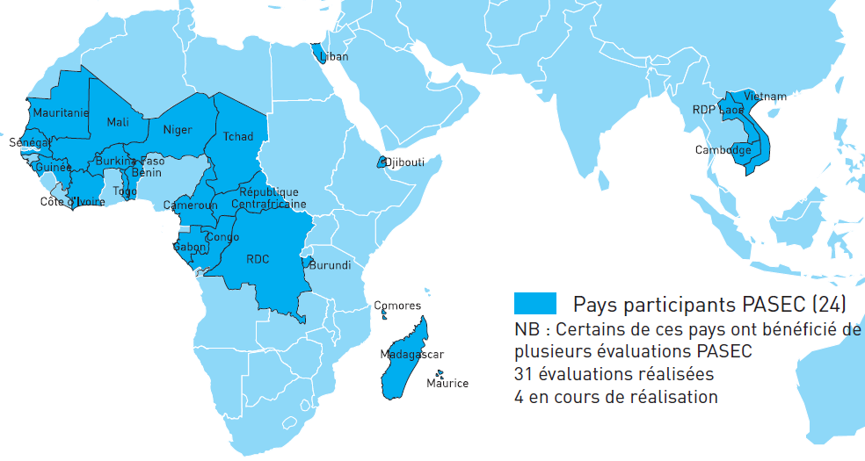
PASEC :
The Programme d’Analyse des Systèmes Educatifs de la CONFEMEN (Education Systems Analysis Program) has been created in 1991. For the past 20 years the PASEC has been running National and Thematic Evaluations under countries’ requests. Since 2012, the PASEC has set up a new framework for international comparative evaluations in 10 African countries.
CONFEMEN (44 countries)

Slide 3
PASEC Objectives:
Identify Basic Education effectiveness and equity factors applying to education systems, schools, teachers and students
Provide indicators to national sector policies for monitoring and mutual comparison, in the francophone area and beyond (via the partnership).
Contribute to the development, at country level, of national education system capacity and foster the research through a knowledge community.
Disseminate evaluation results at international level.

Slide 4
How PASEC operates :
A Steering Committee for defining PASEC strategic orientation and monitoring PASEC action plan;
A Scientific Committee as a warrant of the scientific quality of the PASEC results accordingly to International standards;
At country level, National PASEC teams, composed of national experts in charge of implementation;

Slide 5
At central level (in Dakar CONFEMEN H.Q), a team of Technical Advisors, provide guidance quality control training coordination and communication.
Ressources are provided by
CONFEMEN countries’ contributions
Financial Partners (AFD, WB)
35% of the country evaluation cost is supported by the countries themselves
The selection of countries is made by the CONFEMEN under a process of application from candidate countries;

Slide 6
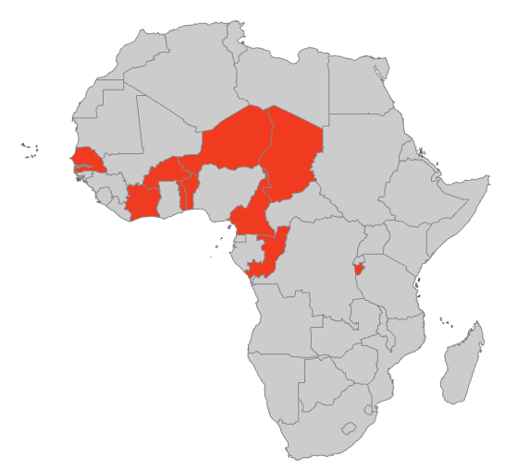
New orientations and methodology for PASEC international evaluations :
10 countries evaluated in 2014 : Benin, Burkina Faso, Burundi, Cameroun, Ivory Coast, Congo, Niger, Senegal, Chad, Togo.
A regular evaluation cycle, every four years ;
Occurring at 3 key moments of the school life :
– Entrance into the schooling (2nd grade of primary);
– End of primary cycle (6th grade of primary);
– End of Basic Education cycle (end of lower secondary school)

Slide 7
New PASEC Evaluation Tools:
The tests are built upon :
Expected basic skills from students in 6th grade of primary school, essential for schooling continuation and recognized by the international community of researchers in pedagogy and education psychology,
Official curricula implemented in the countries.
Tests for students and questionnaires (students, teacher and principals)

Slide 8
3. International PASEC evaluations time table
2012
Call for application, selection of countries
2013
Instruments adaptation and traduction
2014
Test administration in 10 countries
Entering data and processing
Création of new instruments ( test and questionnaires)
Group meetings (2)
2015
Test psychometric analysis
2016
International report
Sampling
Data econometric analysis
Testing of tools in 10 countries
Thematic analysis reflection around national reports
International training (1) and Group meeting(1)
Group meeting(1)
Partnership with SACMEQ
International publication, and dissemination of results (international event)

Slide 9
Other activities:
Construction for PASEC of common skills scales at the end of primary school and at the end of lower secondary school (available in 2015).

Slide 10
4. Context and challenges for a pisa evaluation in africa region
Net intake rate at the entry of lower secondary : between 20% and 45% for PASEC African francophone countries
Weak competences at the exit of the primary school with repercussions on the lower secondary:

Slide 11
Issues at stake:
Adapt questionnaires to field reality
Adapt data collection procedure to field reality and resources constraints.
What proximity operational support could be given to some countries having weak national evaluation systems and limited resources (human and equipment) ?
Taking into consideration students skills for those at the bottom of the PISA scale.
What methodology for sampling the population of out of school youth ?
What type of skills should be evaluated for out of school youth ( having been or not in primary school) ?

Slide 12
Merci de votre attention
www.confemen.org
pasec@confemen.org

